Slide 1
Lecture -2 Supervised Learning

Slide 2
Supervised Learning
Learning a discrete function: Classification
Learning a continuous function: Regression

Slide 3
Types of Supervised Learning
Classification: To predict the outcome of a given sample where the output variable is in the form of categories (discrete values). Examples include labels such as male and female, sick and healthy.
Regression: To predict the outcome of a given sample where the output variable is in the form of real values (continuous values). Examples include real-valued labels denoting the amount of rainfall, the height of a person.

Slide 4
Regression
Regression is divided into types:
Linear Regression: Linear regression predictions are continuous values (rainfall in cm, predicting prices etc.)
Logistic Regression: Logistic regression predictions are discrete values (whether a student passed/failed) after applying a transformation function.

Slide 5
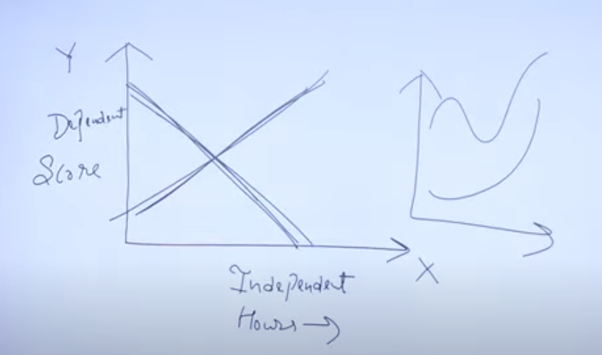
Linear regression
Regression is a statistical method that helps us understand and predict relationship between variables.
Describe how one variable (dependent variable) changes as another variable (independent variable) changes.
Dependent variable: We are trying to predict or explain(Y).
Independent variable: that are used to predict or explain the changes in the dependent variable(X).
For example: predicting salary based on years of experience, predicting exam score based on study, predicting resale based on vehicle sale.
https://www.youtube.com/watch?v=cHT-qLnRm0E

Slide 6
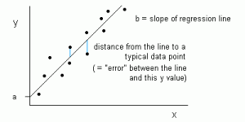
Linear Regression
Linear regression is represented as a line in the form of y = a + bx.

Slide 7

Linear regression
Y represent the dependent variable
X represent the independent variable
m is the slope of the line(How much Y changes for a unit change in X)
b is the intercept(the value of Y when X is 0)
Step 1: Data collection
Step 2: Calculations
Step 3: Prediction
Step 4: Visualization

Slide 8
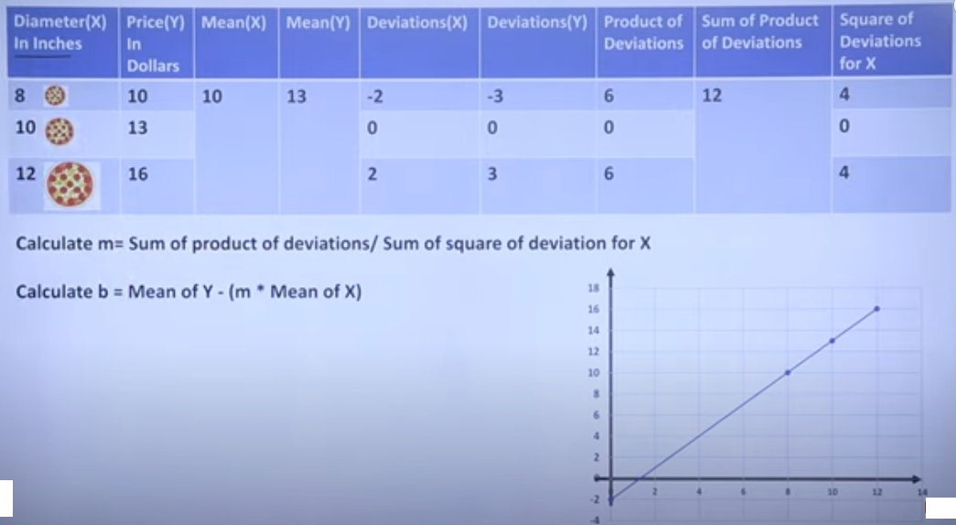
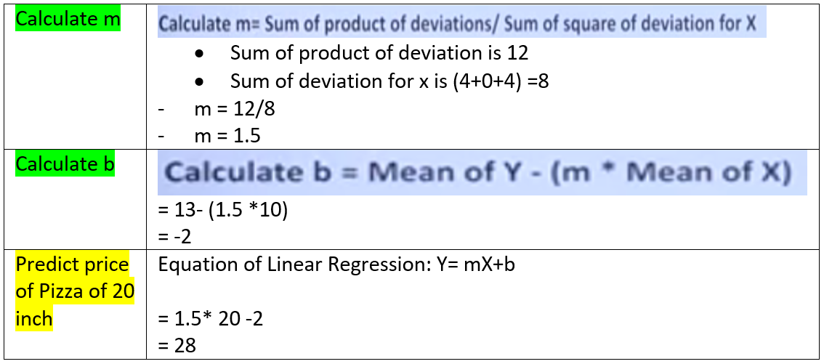
Linear regression
https://www.youtube.com/watch?v=zUQr6HAAKp4&t=14s

Slide 9
Simple Linear Regression Code in Python

Slide 10
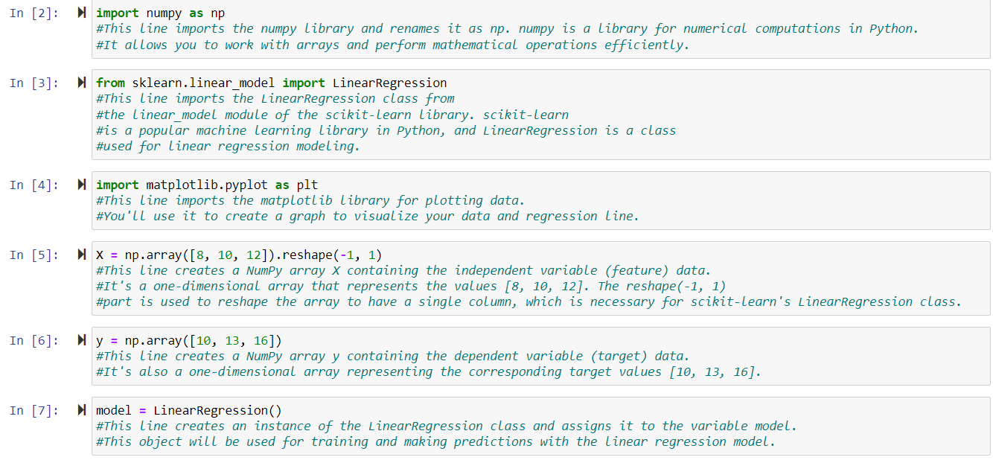

Slide 11
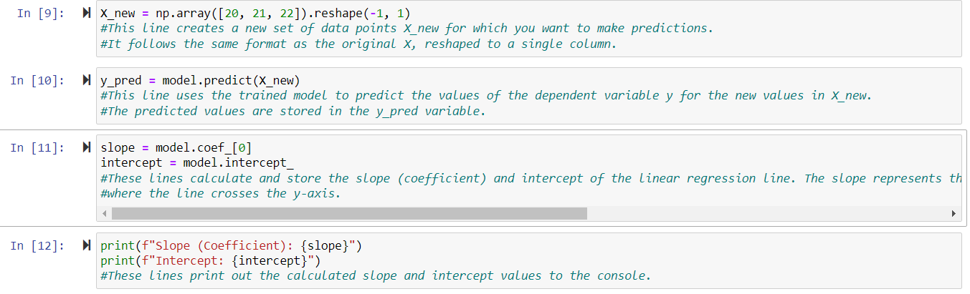

Slide 13
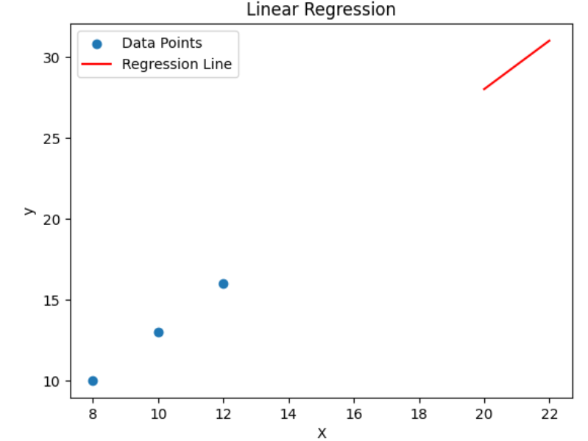
Output of Python Programme

Slide 14
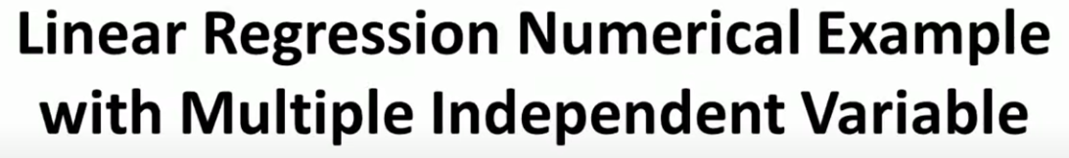
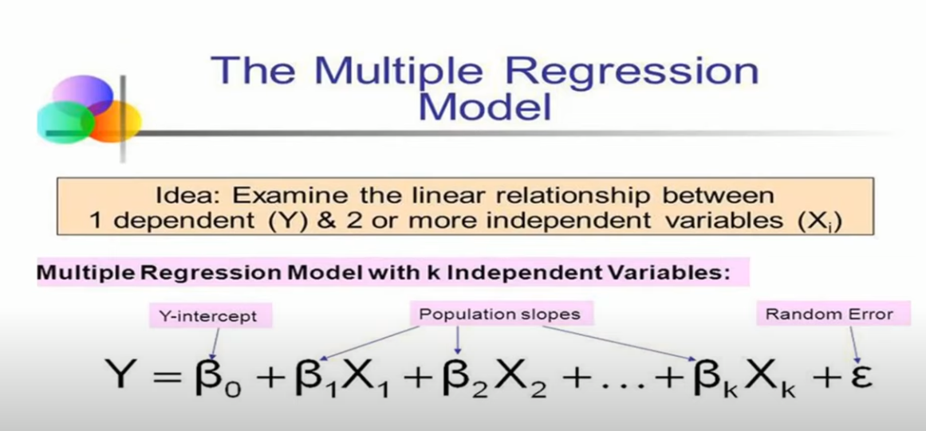
https://www.youtube.com/watch?v=_Q2e4FYkVNg

Slide 15
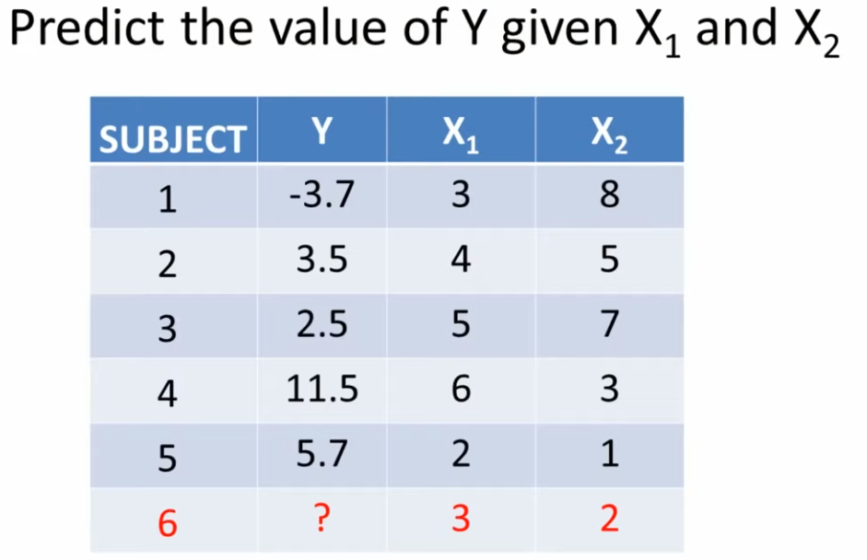

Slide 16
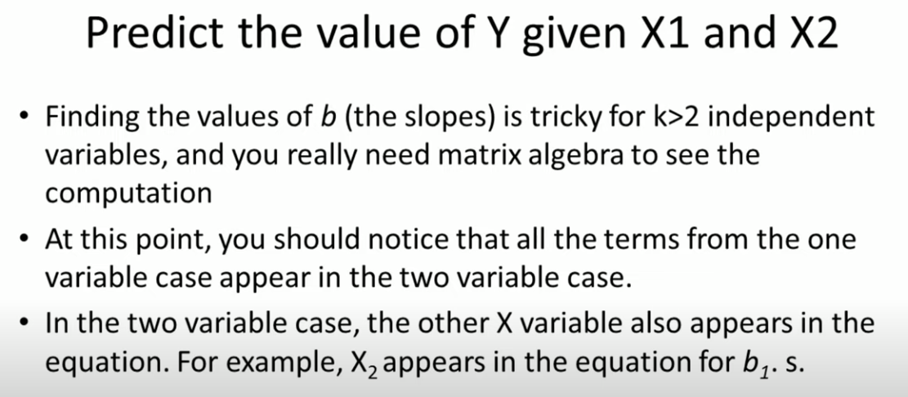

Slide 17
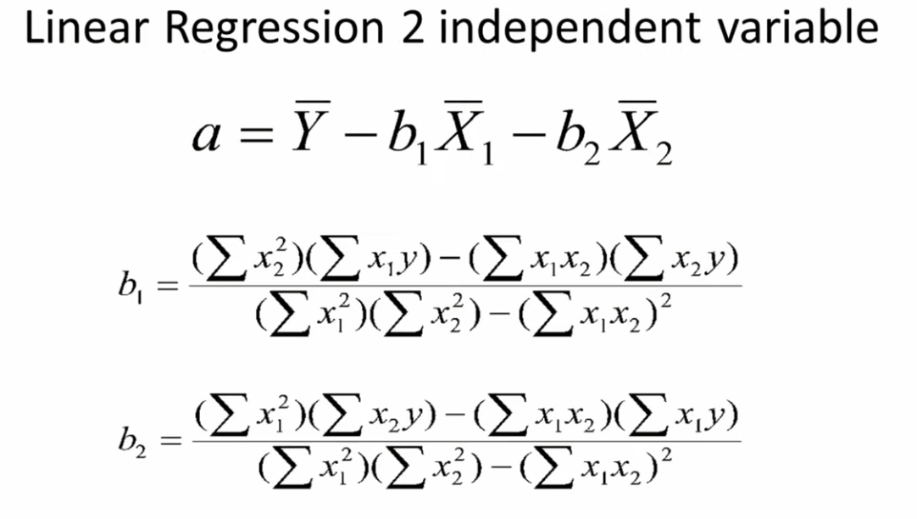

Slide 18
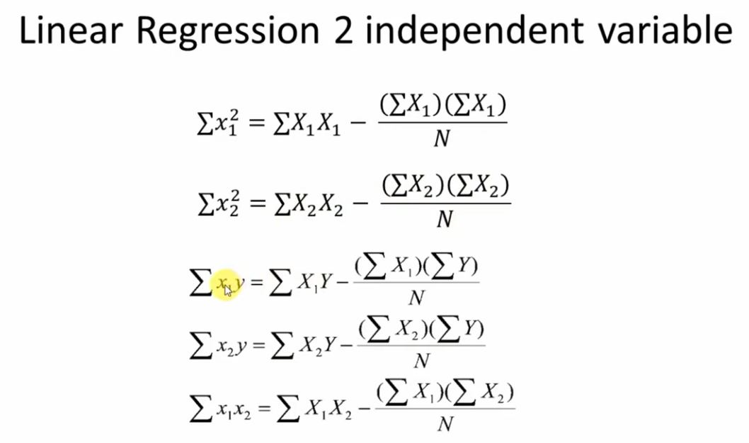

Slide 19
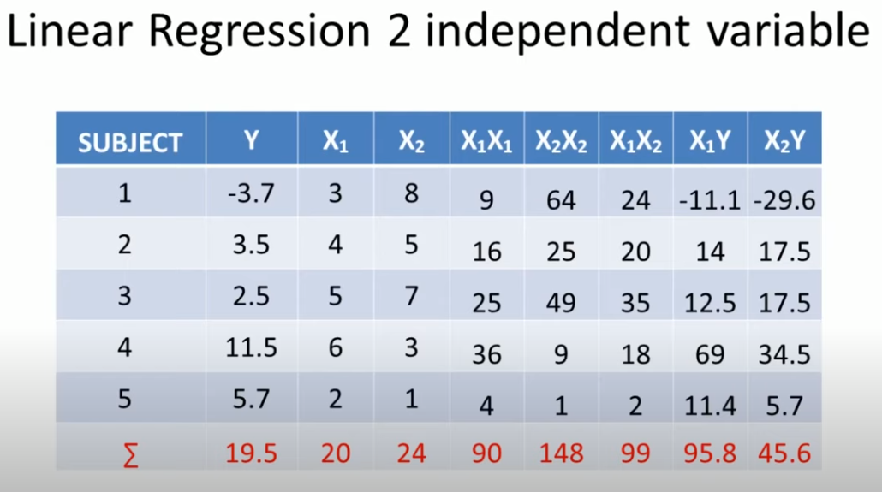

Slide 20
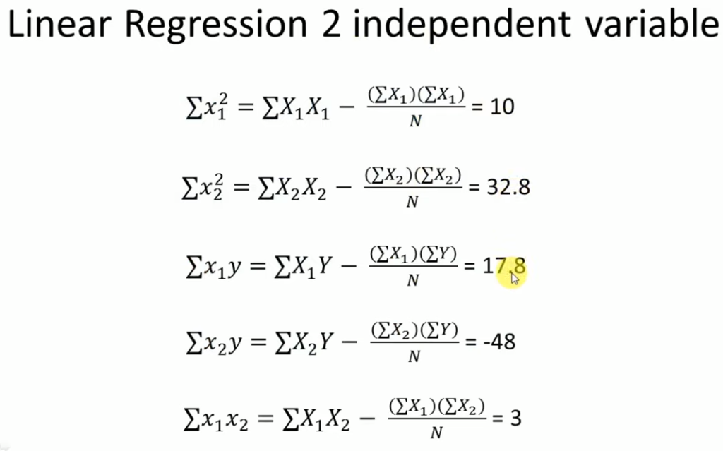

Slide 21
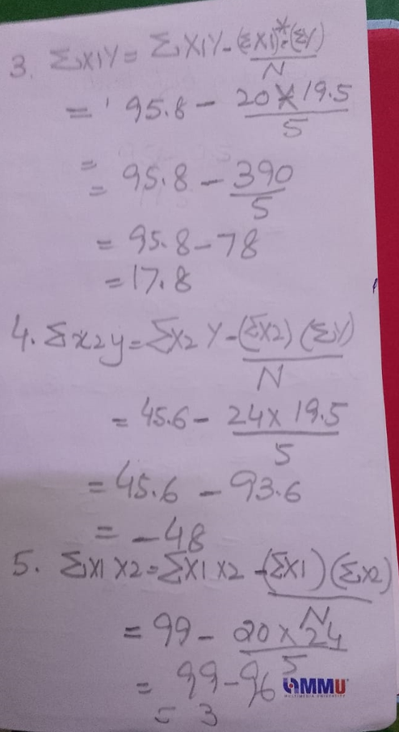
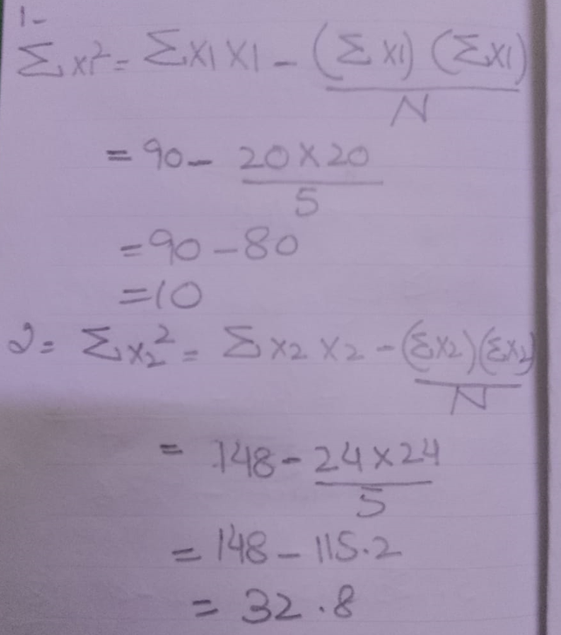

Slide 22
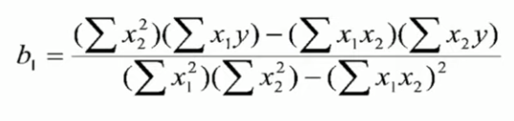
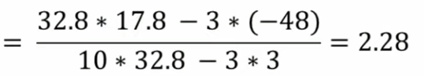
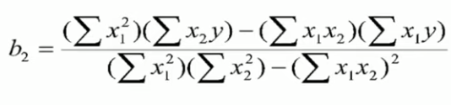
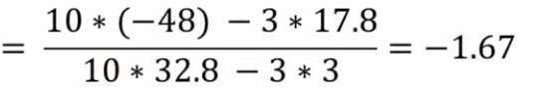
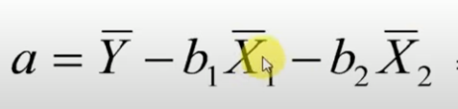
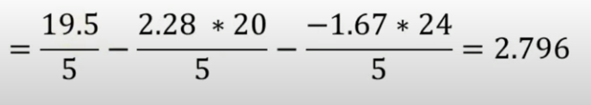

Slide 23
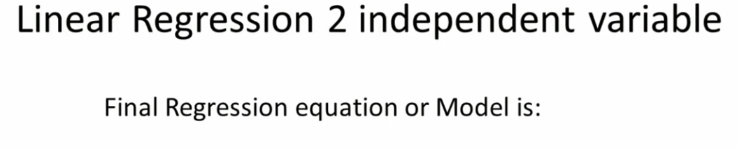
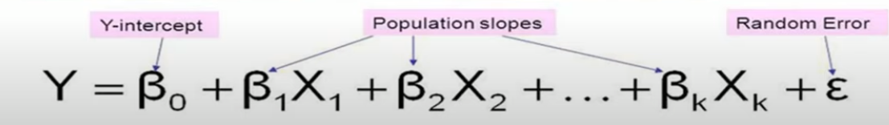
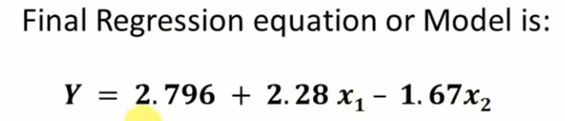
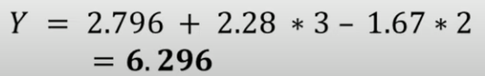
https://www.youtube.com/watch?v=_Q2e4FYkVNg

Slide 24
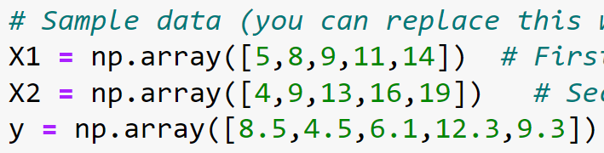
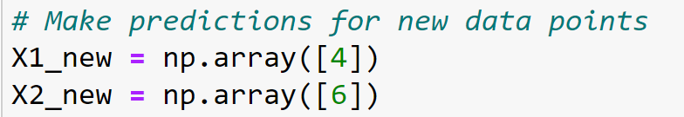
Multiple Linear Regression Code in Python
Home WORK

Slide 25
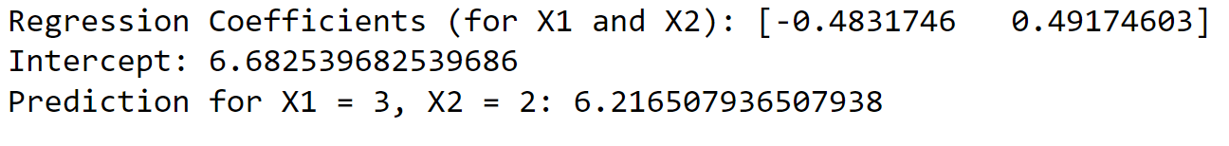
Answer

Slide 26
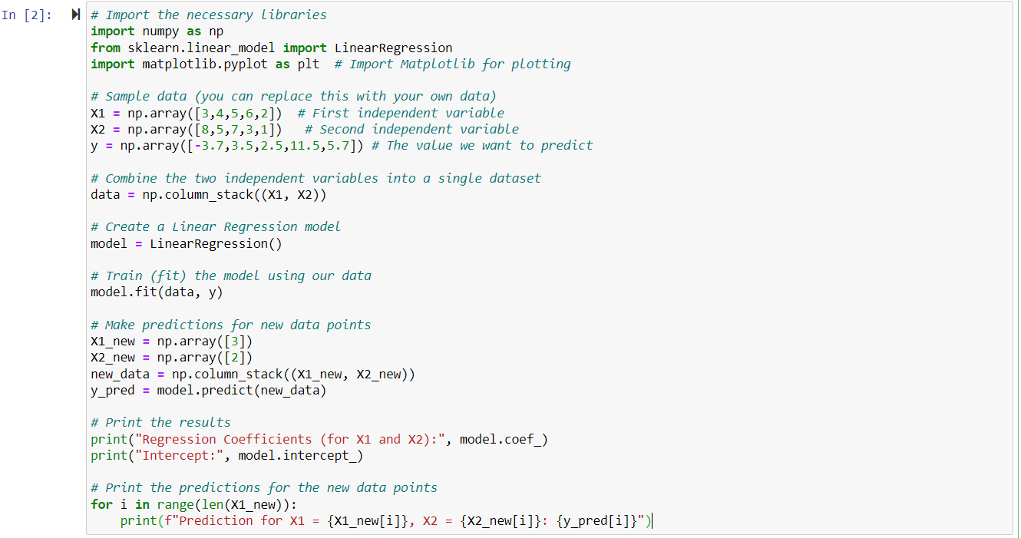
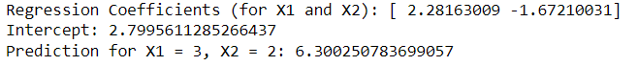

Slide 27
Logistic regression
Supervised classification model
Depending variable is categorical and binary (0 or 1)
Study Hours | Exam Result
2 | 0
3 | 0
4 | 0
6 | 1
7 | 1
8 | 1
5 | ?
https://www.youtube.com/watch?v=r8OjlgWpAI0&t=520s

Slide 28
Logistic regression can also be used in the following areas:
in healthcare to identify risk factors for diseases and plan preventive measures;
in drug research to tease apart the effectiveness of medicines on health outcomes across age, gender and ethnicity;
in weather forecasting apps to predict snowfall and weather conditions;
in political polls to determine if voters will vote for a particular candidate;
in insurance to predict the chances that a policyholder will die before the policy's term expires based on specific criteria, such as gender, age and physical examination; and
in banking to predict the chances that a loan applicant will default on a loan or not, based on annual income, past defaults and past debts.

Slide 29
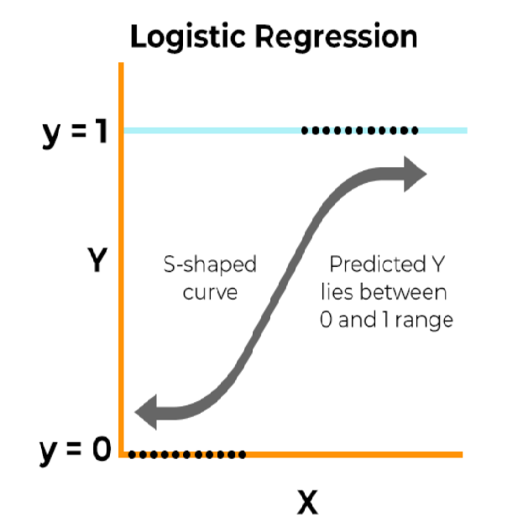
Logistic regression

Slide 30
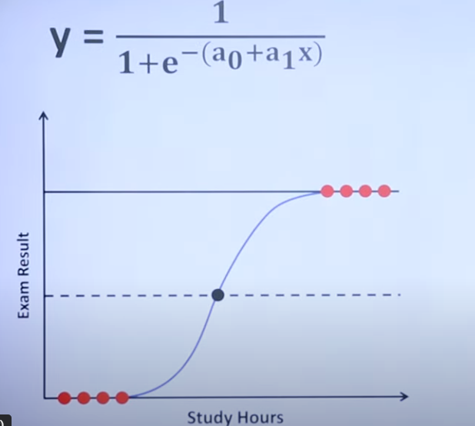
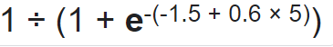
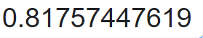
Logistic regression- numerical example 01
a0 = -1.5
a1 = 0.6
X= 5
=
=

Slide 31
Logistic regression- multiple variables
Lets say that we have a training set of 500 data
X1 | X2 | Y
2.1 | 2.5 | 0
1.4 | 2.3 | 0
3.3 | 4.4. | 0
8.06 | 3.05 | 0
5.3 | 2.75 | 1
2.7 | 2.5 | ?

Slide 32
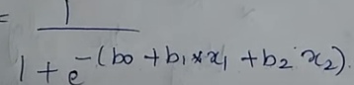
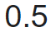
Logistic regression- numerical example with Multi Variables
Y
Initially we assume B0 = 0.0 ,B1 = 0.0 & B2= 0.0
Let’s take X1 = 2.7,X2 = 2.5
Y = ?
Y =
Y =
https://www.youtube.com/watch?v=ozG1Ar6B_t4

